Slide 1
TSDS Upgrade Support Meeting
ESC Region 11 Friday, November 8th 9:00 AM

Slide 2
AGENDA
Upgrade Support Spreadsheet
Data Processing Flowchart (ESC18)
TEA Updates
Fall PEIMS
DMC Export Data
Staff Responsibilities
Programs of Study
ECDS
Questions or Comments

Slide 3
TSDS Upgrade Support spreadsheet
https://docs.google.com/spreadsheets/d/1Xyh96WBO0GWc0ZC_W77ffnZwzwABK58Wth--6vpiLhc/edit?gid=0#gid=0

Slide 4
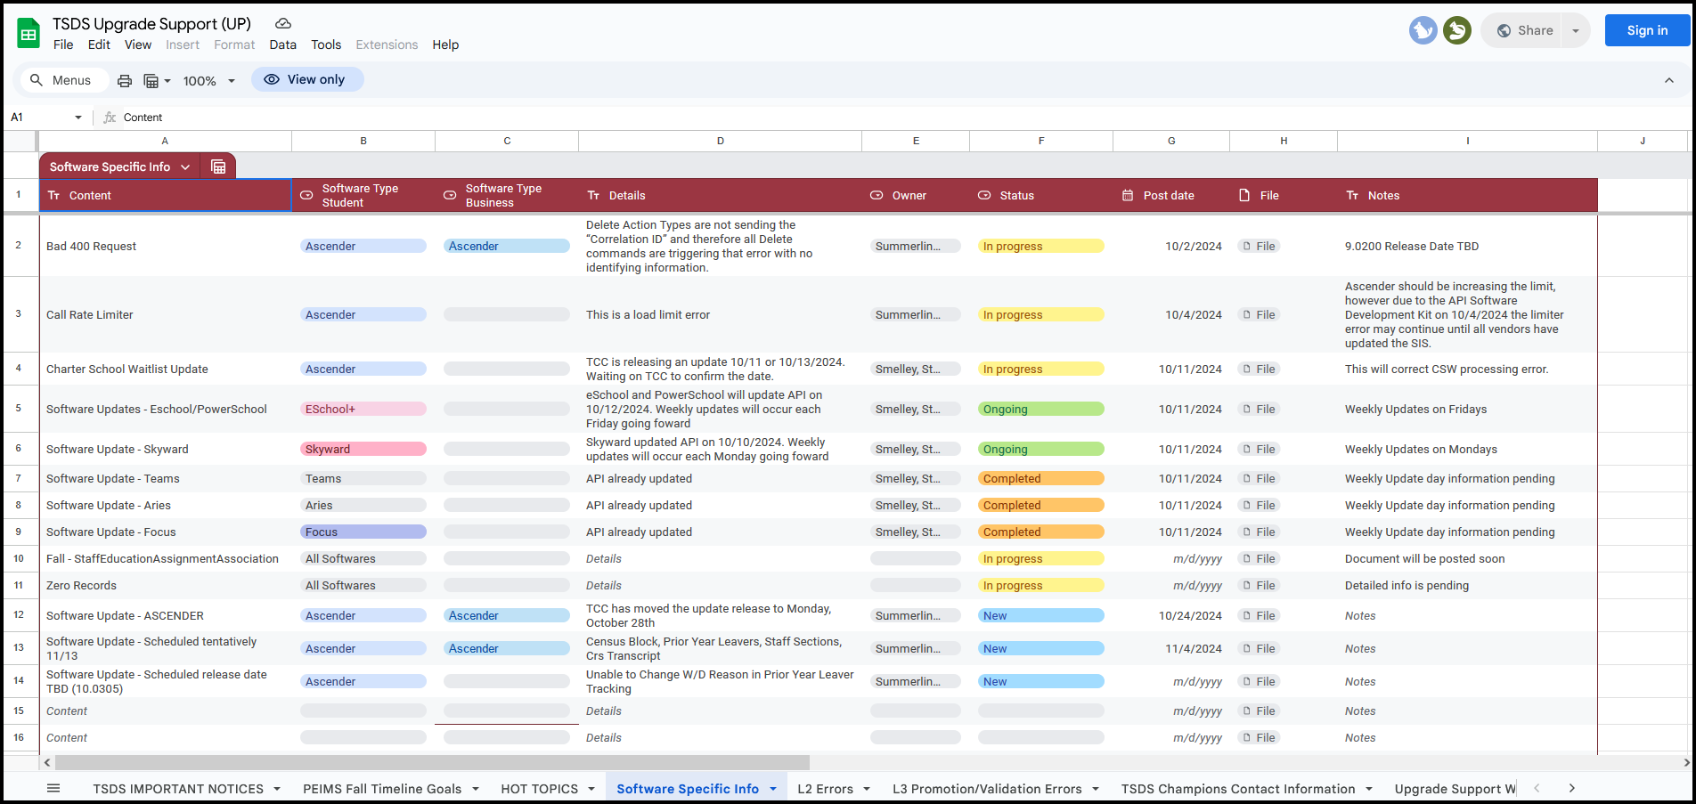
TSDS Upgrade Support spreadsheet

Slide 5
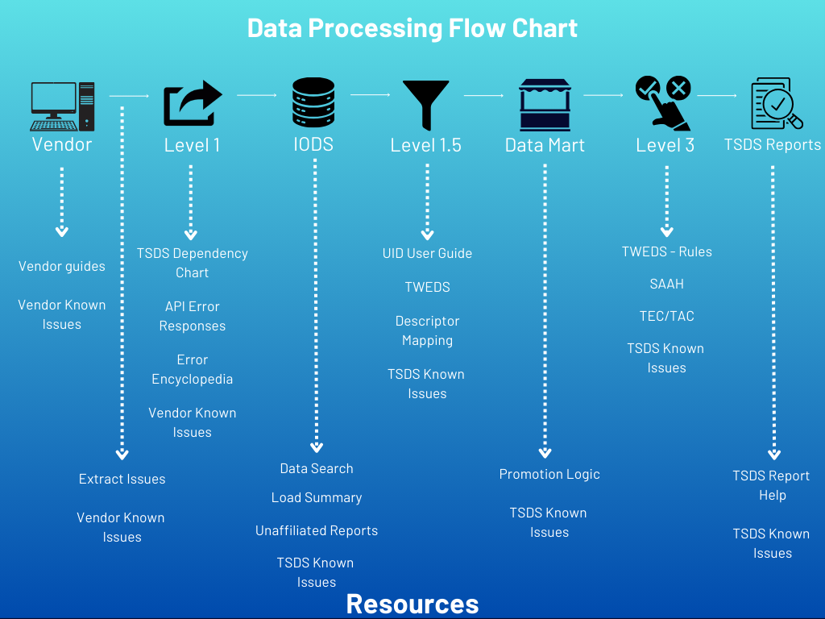

Slide 6
TARGET SET BY TEA FOR VENDORS

Slide 8
ESC REGION 11 Fall PEIMS Timeline Status As of November 7th
DATE | METRIC | TARGET | ACTUAL
November 8th | LEAs Publishing Some Data to IODS | All | 95/96
November 15th | LEAs Publishing All 23 Entities | All
November 20th | LEAs Promoting All Entities | All
December 2nd | LEAs Have Less Than 100 Fatals | All
December 12th | LEAs Have Completed Fall PEIMS | All

Slide 9
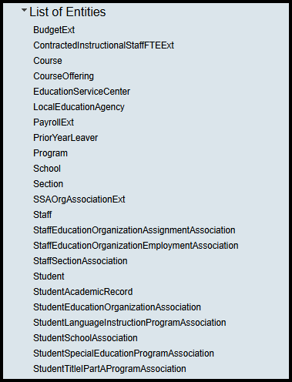
FALL PEIMS EnTITIES

Slide 10
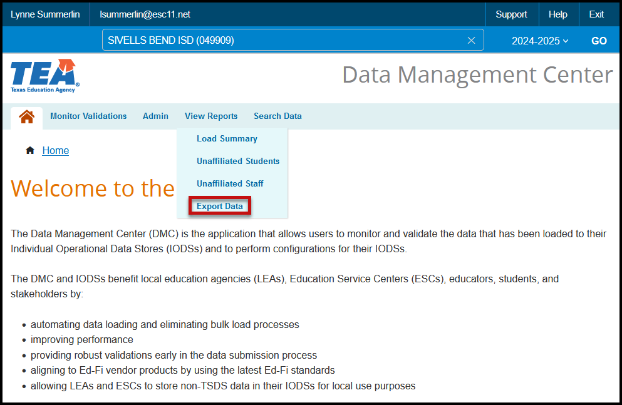
DMC Export Data

Slide 11
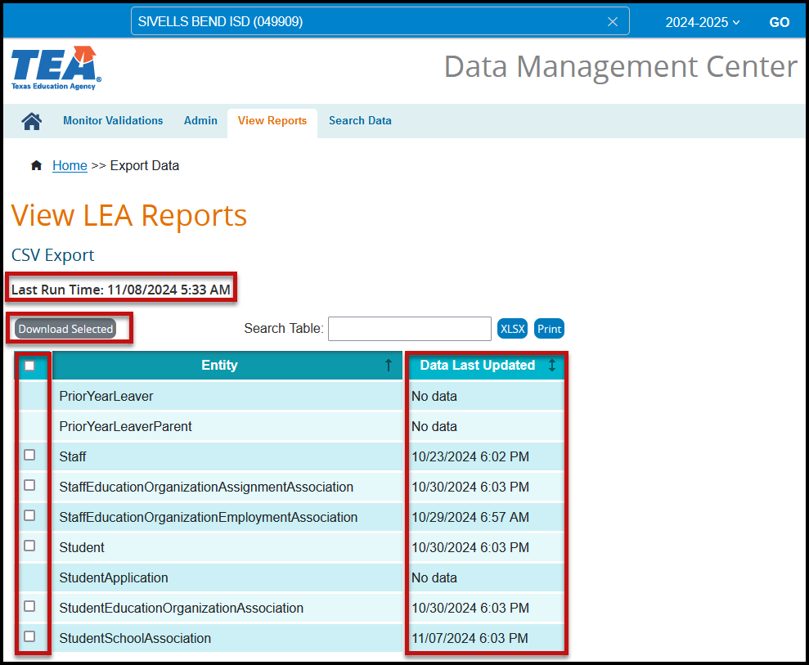
DMC Export Data

Slide 12
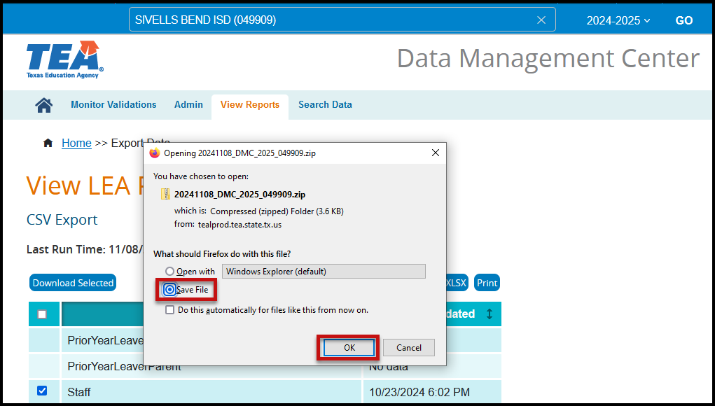
DMC Export Data

Slide 13
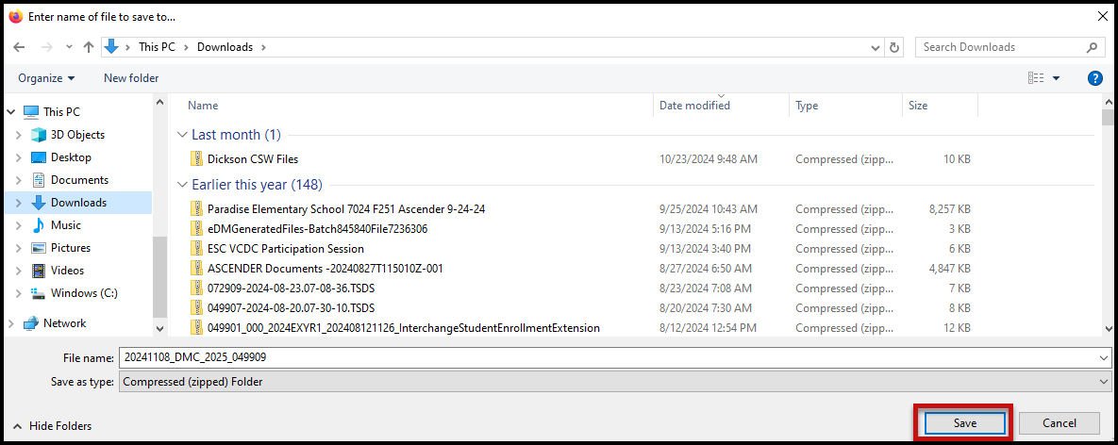
DMC Export Data

Slide 14
DMC Export Data

Slide 15
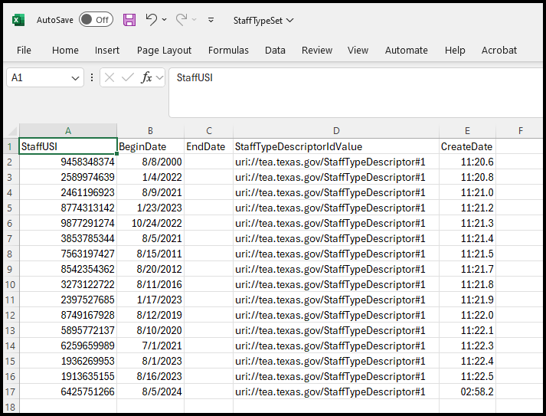
DMC Export Data

Slide 16
Staff Responsibilities

Slide 17
Fall PEIMS - Programs of study - CCMR
https://tea.texas.gov/academics/college-career-and-military-prep/career-and-technical-education
ESC 11 Accountability Website
ESC 11 CTE and CCMR Website

Slide 18
Programs of study

Slide 19
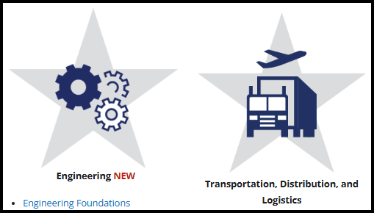
Programs of study

Slide 20
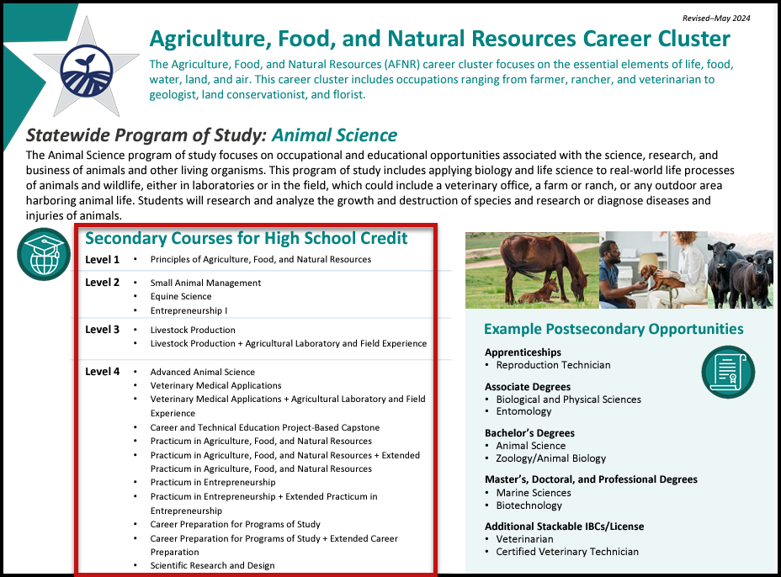
Programs of study Courses

Slide 21
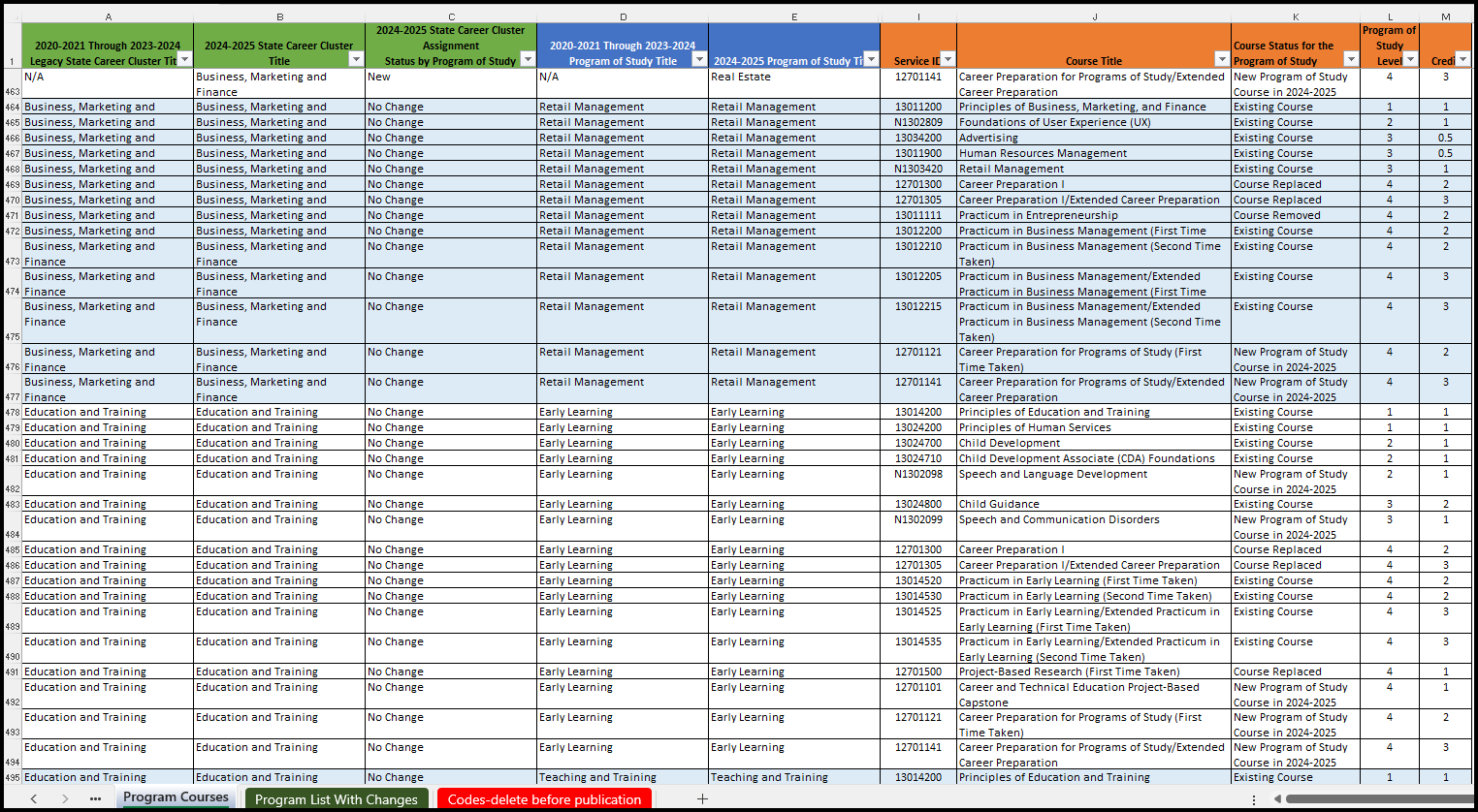
Programs of study Crosswalk

Slide 26
Questions and Comments

